Slide 1




Education in a Boarding School in Afghanistan
Team Members:
Juan Pablo Blandon Quintero
Ximena Zapata Gonzalez
Juan Cabrera
Yilmer Adrian Ortega Florez
Luis Fernando Quiceno Corrales

Slide 2



Content
1.Introduction.
2.Video Explanation.
3.Importance of Education
Brief explanation of the topic.
Summary of the video.
Why Education Is Important For Gir’ls.
4.Real-life Example
5.Conclusion.
6. Purpose/Goal of the presentation
Connection of the video with real life.
Group opinión and final reflexión.
Thank you very much for watching our presentation.

Slide 3

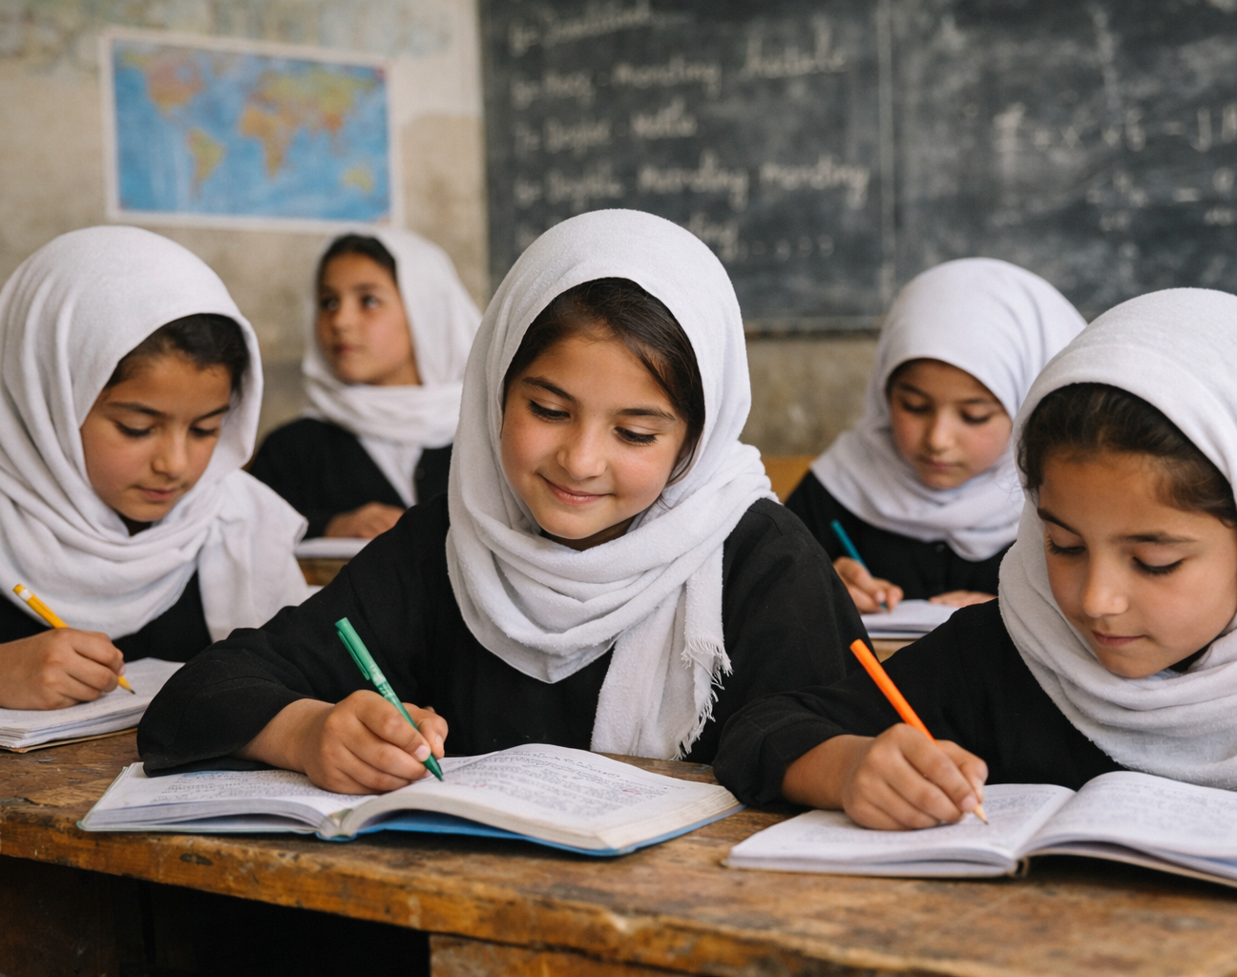



Introduction
This Presentation is about a boarding school in Afghanistan.
It shows how girl’s study and the challenges they face
We Will Explain Why Education is important and share a real-life example.

Slide 4

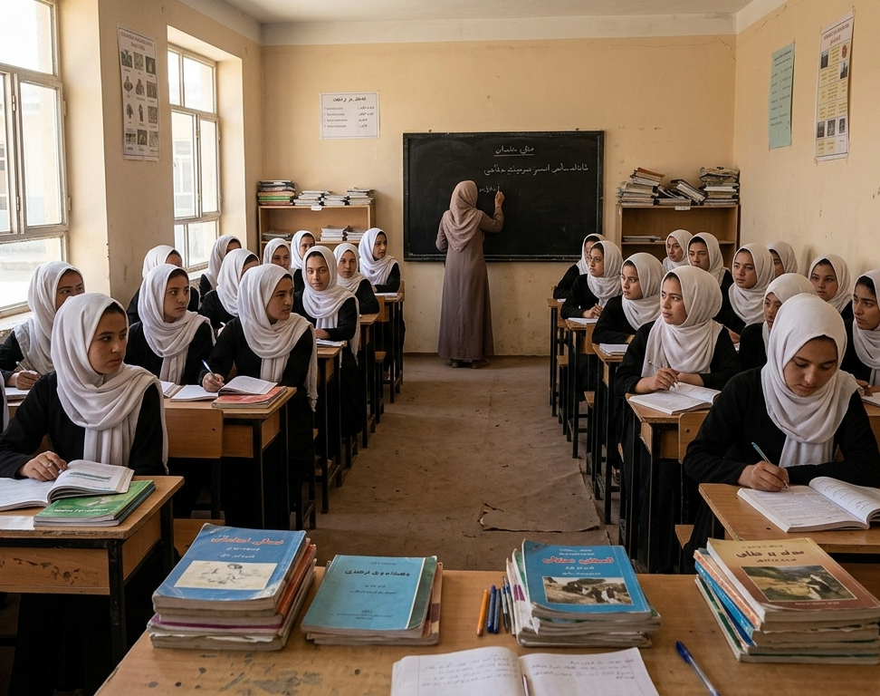


Video Explanation
The video shows the challenges and opportunities girls face in afghanistan schools,highlighting the importance of education for their future and personal growth.

Slide 5

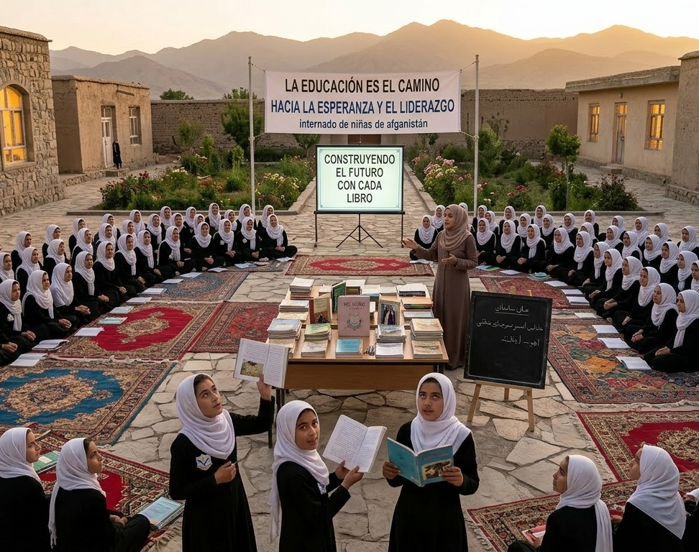

Importance education
Education provides knowledge and skills,develops critical thinking,promotes equality,and empowers girls to build a better future.

Slide 6

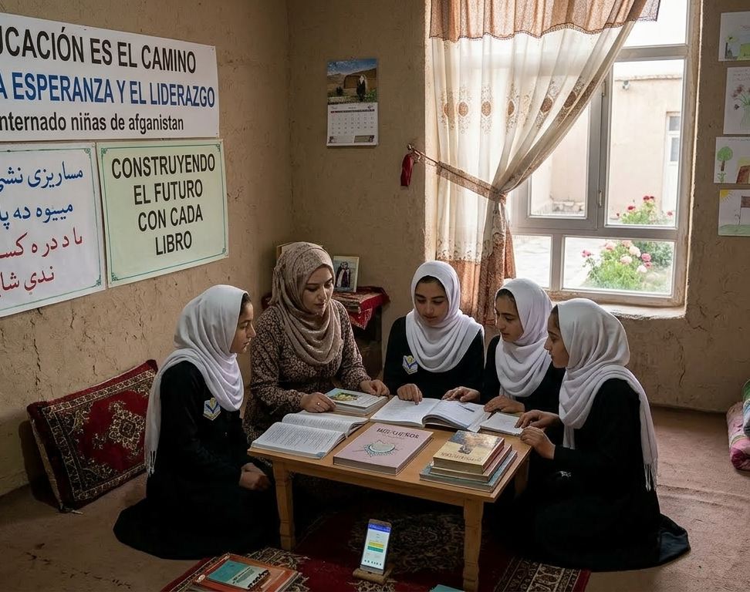


Real-life-Example
Real-life-Example
A girl who was not allowed to attend school learned to read and write in secret,and later became a teacher to help other girls get an education

Slide 7

Conclusion/Group Opinion
As a group,we believe education is essential for every girls future and can make a positive impact on society

Slide 8

Purpose/Goal of the presentation

